Slide 1
Dependency Injection
Dependency Injection makes our programming code loosely coupled and easier for testing.

Slide 2
Technology & Platform
Platform: Java, Spring Boot
Documents: DI/IoC Architecture Diagram

Slide 3
What & Why Dependency injection
Dependency Injection makes our programming code loosely coupled and easier for testing.
DI(Dependency Injection) is an implementation to achieve IOC( Inversion of Control).
IoC: IoC enables a framework to take control of the flow of a program. Container is responsible for instantiating, configuring and assembling objects known as beans, as well as managing their lifecycle

Slide 4
Points Covered
Types of Injection
1. Constructor Injection.
2. Field injection.
3. Lookup Method injection (Scope based).
4. Setter injection.
How @Scope annotation is affecting DI(Dependency Injection).
Singleton based & Prototype based injections.
Use of @Qualifier annotation in DI(Dependency Injection).
Order of Injection.

Slide 5
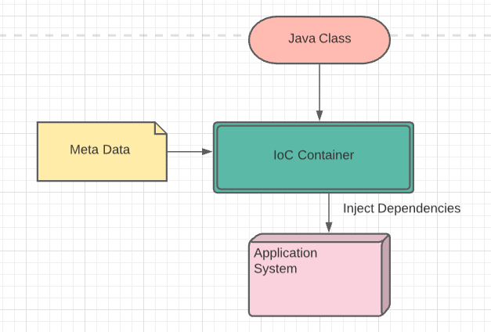
Dependency injection diagram

